Slide 1
Event leadership theory and practice for Event management and event tourism
Dr Emma Abson

Slide 2
Instructor lecture slides
These are the instructor’s lecture slides produced to accompany the book Event Leadership – theory and practice for event management and event tourism, by Emma Abson (with chapter contributions by Miriam Firth and Jane Tattersall), 2021, published by Goodfellow Publishers Ltd. These lecture slides accompanying illustrations are provided by the authors for the private use of instructors using the book Event Leadership. All the diagrams are copyright protected and should not be circulated beyond the classroom. To further support instructors, there is a set of PowerPoint slides for each lecture available.

Slide 3
Lecture 8 – Events, leadership and power

Slide 4
Lecture 8 – Events, leadership and power
Image: https://unsplash.com/@pavement_special

Slide 5
Lecture 8 learning outcomes
Consider the question who leads and when?
Explore the power of leaders
Understand the different types of power
Reflect on the power of events to lead change in society
Reflect on the power of event communities
Discuss the nature of power relationships with event stakeholders

Slide 6
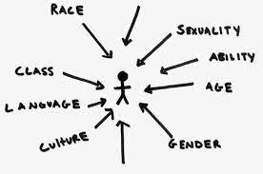
Power dynamics within event leadership
In viewing leadership as both a process of influence AND a process of power, we can gain useful insights into the power relationships that may be at work.
Notes:
A criticism of many of the conceptualisations of leadership is that they tend to focus on the positive nature of leadership and ignore the issues of power, influence and domination (Bolden 2011). This really is a key criticism, because when you think about it, how can leadership be untangled from the power dynamics that occur within and around it? Despite the rise in viewing leadership as an influence process, as charted in chapters 3,4 & 5 of this book, leadership in events is still often attributed to those in formal positions of power – by that I mean those in managerial positions, who have the power to make decisions about their followers working lives and even – at the extreme end – decide to terminate people’s employment. Critics such as Bolden (2011), Alvesson and Spicer (2012) argue that when leadership is the preserve of those in managerial positions, then the dynamics of who holds the power in the relationships are always unequal, and it is impossible to overcome these inequalities, because one person is always in a stronger position than the other.
This is certainly a concern for event management and the related sectors such as destination management organisations which, because of the dynamic, fast paced nature of the work, often rely on team members accepting leadership from those who aren’t in formal leadership positions. This chapter therefore gives the reader a brief overview on the power of leaders in events, and an insight into both the benefits and issues of that power.
A second level of concern is also leadership within the events community - who is it that brings people and organisations together? What does it take to achieve effective collaboration among events and between events and other key stakeholders? This might be a matter of individual leaders taking charge, but equally it could be that leadership emerges from specific network dynamics.

Slide 7
The power of leadership
What do we mean by power? Power is most commonly defined as the ability of an individual to exercise some sort of control over someone else.
Leadership, on the other hand, should not be solely bound up with power – after all, an individual can have the ability to influence others, despite not being in a formal – powerful – leadership position.
In other words, people with power have the ability to influence others AND the ability to exert control over others. Leaders will have the ability to exert influence over others, but they do not necessarily have the power to make people do what they want.
Notes:
Leaders must exercise their power carefully because power is simply the right to provide leadership. As Warren Bennis famously suggests, ‘leadership is the wise use of power. Power is the capacity to translate intention into reality and sustain it.’ (Note: this citation is widely attributed to Bennis, but there is no original source data. Be careful if you reuse this quotation in your assignments!)
Therefore, following this line of thinking, event leaders have power over a multitude of situations at work. That doesn’t necessarily mean that they should use power over the people they lead – good leaders will not need to display their power in order to get results, instead they will empower others. But of course, bad leaders exist, and many will misuse their power.

Slide 8
What do we mean by power in event leadership?
Event leader /managers are the ones who usually decide:
How much people get paid
Whether or not to reward staff with financial bonuses
What work each staff member will do
To allow holiday requests
And event leaders decide things like:
Who will feature on their event programme
Which supplier they will use
How much they will pay their suppliers
Which sponsor gets the best spot in the VIP lounge
Who sits where at the conference dinner
Notes:
But what do we mean by the power of leaders? In many ways, it is simple – power is the capacity or potential to influence (Northouse, 2013). Those in formal leadership positions have the power to make a range of decisions that will impact on the people who work for them. For example, (see slide)
And all of these decisions have power attached to them – for those affected by them, the outcomes can be positive or negative. But there are many different types of power, and given the interconnectedness of power and leadership, it is important we understand what they are.

Slide 9
TYPES OF POWER (Northouse)
Power
Referent
Legitimate
Reward
Coercive
Expert
See next slide

Slide 10
Legitimate power
Legitmate power is the same as authority
Coercive power
Coercive power is the power leaders have to control, manipulate or punish
Leaders in formal managerial positions have coercive power, because they can punish you for not doing as they ask
To understand coercive power, think about how your line manager at work can decide to give you the most unpleasant jobs, or demote or sack you
Legitmate power comes from the power that a leader has because of their position in the organisation
People with legitmate power will often also have reward, coercive and / or expert power - but legitmate power is a wider concept than these
To understand legitmate power, think about how, if a policeman or the boss of your company tells you to do something, you are likely to do it.
Notes:
Type of power, adapted from Northouse (2015)

Slide 11
Reward power
Reward power is the power to give benefits or rewards
Rewards can be financial, or emotional or motivational - basically anything the person values can act as a reward
To understand reward power, think about how you feel when someone in a leadership positions praises you for doing a good job. Or consider how it feels to get a bonus because of your hard work!
Expert power
Expert power is the power given to those who have expertise in a certain field.
To understand expert power, think about how important the audio-visual technician is at an event. You wouldn't be able to run your event well without them, and that means they hold power over you in terms of how well your event is run and one aspect of the quality of the event
Referent power
Referent power is the power that comes from a leaders strong relationship skills
Referent power is very useful in situations where command and control are less acceptable, and collaboration and influence will gain greater results
As organisations move away from traditional hierarchical leadership structures, referent power becomes more important
In other words, referent power happens when followers respect and / or admire their leaders
To understand referent power, think about someone who you admire so much that you try to behave like them. That person has referent power over you.
Notes:
Type of power, adapted from Northouse (2015)

Slide 12
Who leads, and when?
Most event organisations are structured around a typical hierarchical structure, with organisational teams each managed by team leaders, and a chain of command that reaches up to a leadership team who make the strategic decisions on the vision and direction of the organisation. It is risky then for us to ignore the role of a formal leader when – in nearly every type of organisation – they are still an essential part of the structure. Indeed, researchers now recognise that in order to fully understand leadership processes, both vertical (top-down leadership) and collective leadership throughout the organisation need to be considered.
Image: https://unsplash.com/@markusspiske
Notes:
Unlike other industries such as banking or manufacturing the output of the event community is based on the consumption of an experience (Pine and Gilmore 1999) – what people pay for, or sign up to, isn’t a tangible product and nothing can be taken away (Pernecky 2015). This intangibility means that perceived consumer experiences are central to a successful event – but it also creates significant challenges in shaping experiences that create a lasting legacy, or changes to consumer thinking and behaviour - which are integral to successful outcomes. Similarly, experiences are also temporary in nature - they are planned for, staged and then they disappear - this is true even of recurring event experiences (Bladen, Kennell, Abson and Wilde, 2018). This temporality results in inevitable and ever-growing pressure to deliver - there is only one chance to get things right, and mistakes in planning or delivery are very difficult to rectify when the experience is underway (Van der Wagen 2006; Bowdin, Allen et al. 2011). And, because the work is often geared towards one particular point in time – that of the experience delivery – there is an associated, and increased, risk of job insecurity and poor working conditions, for example very long and unsocial hours (Evans, 2015). This then leads to the key issue of power – that ever-growing pressure, which culminates in that ‘it has to be alright on the night’ feeling, means that decisions need to get made quickly, and those that have the power to make the decisions are therefore looked to as leaders (whether they want to be or not). Ultimately during the live delivery of an event, there is usually one person with whom all the decisions rest and power is therefore enshrined in the role – what they decide to do is what will happen.

Slide 13
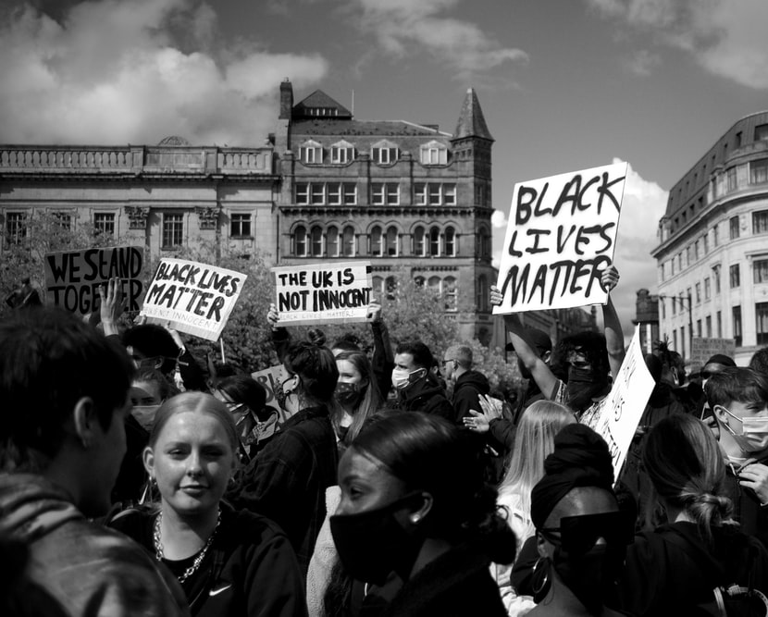
Access to power – discrimination and leadership
There is a tendency to focus on the positive aspects of leadership
But with power, also comes the potential for exploitation and discrimination.
Power- or the lack thereof - may well be evident in the degree of participation of leadership and the process of leadership itself and how it can be bestowed on people may well exclude certain people. This of course has huge implications in terms of diversity and equality. Given the recent rise in global consciousness about these issues, questions must be asked about how much access to power those who face structural inequality in the event industry because of their gender, sexuality or race will have.
Image: https://unsplash.com/@sushilnash
Notes:
Note to instructors – you could also discuss here the difficulties with access to power, and the problems this causes in terms of diversity and the exclusion or ‘othering’ of voices. This is covered in the book in chapter 8, as follows:

Slide 14
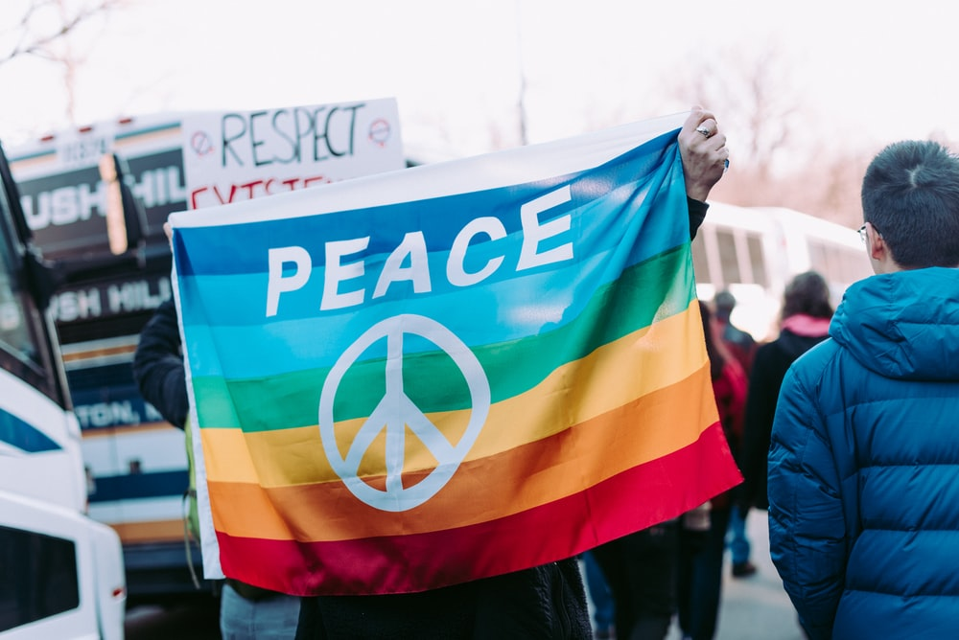
Lack of inclusion – it’s an event problem
The Event Manger Blog looked at 150 events to determine how diverse the speaker panels really were. They found that between 35-40% of events they looked at didn’t have one black speaker and, if that was widened out to include BIPOC (black, indigenous and other people of colour) and female representation, the overall picture is still really poor.
This is problematic, because events are platforms and many believe they have a duty of care to provide space for all, or at least a level playing field for diverse voices. And of course, there is huge value in not just ensuring that all areas of event communities are represented but also because diversity means a greater richness in knowledge and experience and leads to a much more interesting event.
Image: https://unsplash.com/@alicekat
Notes:
Another concern is also the lack of diversity, inclusion and representation at events themselves. In a piece of research conducted in 2020, the Event Manger Blog looked at 150 events to determine how diverse the speaker panels really were. They found that between 35-40% of events they looked at didn’t have one black speaker and, if that was widened out to include BIPOC (black, indigenous and other people of colour) and female representation, the overall picture is still really poor. And this is problematic, because events are platforms and many believe they have a duty of care to provide space for all, or at least a level playing field for diverse voices. And of course, there is huge value in not just ensuring that all areas of event communities are represented but also because diversity means a greater richness in knowledge and experience and leads to a much more interesting event.
As I have already made clear, little is known about leadership and power within the event community – however, when we look at leadership research in general, it becomes clear that the exclusion of ‘different’ voices limits participation in leadership and that power has a clear influence on relationships at work and in access to event spaces and event platforms.

Slide 15
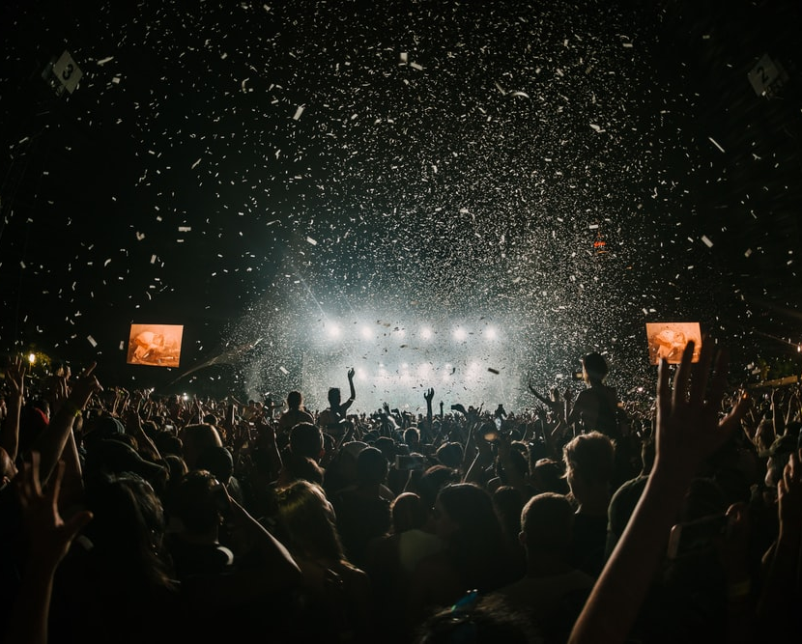
The power of events and event communities
Events can be catalysts for change
When we conceptualise events in this way, it becomes clear that the event experience itself can be a form of leadership.
We can think of events as powerful in two ways – firstly, we can think of the event organisations power, in terms of setting the agenda, deciding on the programme for events, and amplifying key issues (such as the way Glastonbury places sustainability and recycling at the heart of its event objectives).
Secondly, we can think about the power that the event communities themselves have – the power of people coming together to bring about change.
Both of these types of power are examples of leadership – the power of events therefore lies in their ability to lead change.
Notes:
Crucially, as Rojek (2013) suggests, we must remember that events are not normally spontaneous or expressions of people power – they are well organised, often with motivations to persuade or even to manipulate the ‘market place’; the ownership of events rarely rests with the people, and whilst they might involve parts of society joining together to celebrate (e.g. the opening ceremony of the Olympic games) or to do good (e.g. the 2020 One World: together at Home concert or Live Aid in the 80s), they are underpinned by a hierarchical structure that is often designed to keep the people in their place.

Slide 16
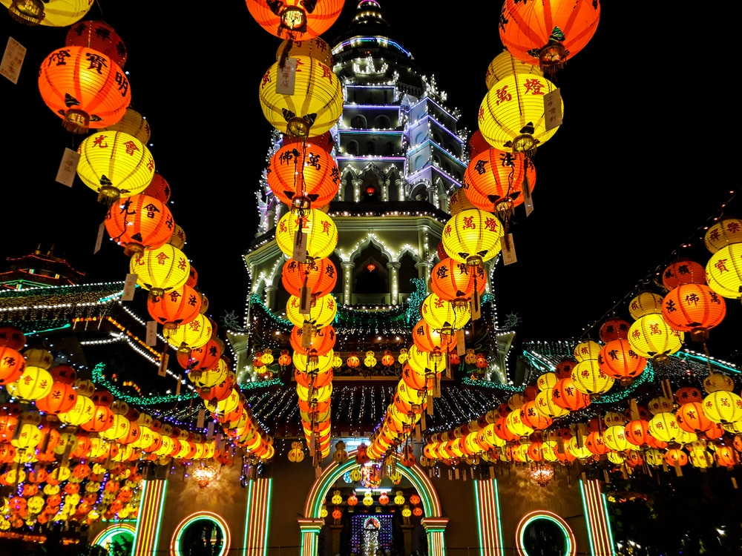
Events as displays of social / cultural capital
Events have become displays of social or cultural capital (as coined by Bourdieu).
Social and cultural capital is made up of an individual’s social assets – the skills, education, norms and behaviours that are acquired by a social group, and which give them economic and social advantages.
Events are an excellent way for individuals to display these advantages - whether by bringing people together to celebrate the successes of a country’s athletics team, or putting on a concert to raise awareness of a particular issue, people are often tempted to display their attendance at events as badges of honour, and as examples of their advantages in society.
Image https://unsplash.com/@wxshutterbug

Slide 17
Events have the power to do good
Events have a role to play in society – they have the power to bring people together, to create and consolidate communities, to generate vast sums of money for good causes and they can raise issues to the global consciousness.
Events can be seen to be using their power of influence, and their reach, to lead on social or cultural change. Some events now put delivering long term, profound differences at the heart of what they do; others are simply taken over by protests that shift perceptions and raise awareness of societal problems.

Slide 18
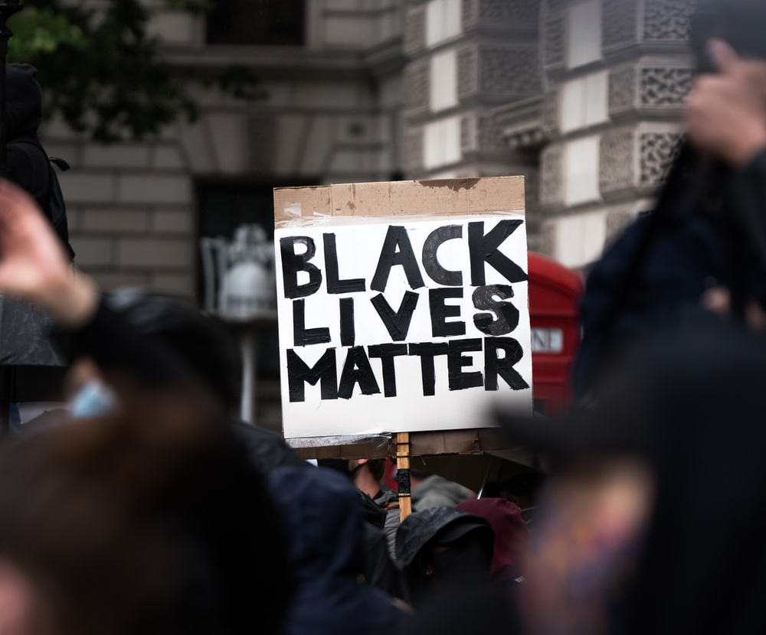
Examples of events that use their power to attempt to bring about real difference:
Black Lives Matters Protests
Rock against Racism concert in the 1970s
Live Aid concert in 1985
One Love Manchester benefit concert in 2017.
Image: https://unsplash.com/@eadesstudio
Notes:
It is important to note, however, that most events that have social responsibility or driving change as a core objective don’t make international news. Many small-scale local events are created specifically to share knowledge, build communities and bring about change – examples include events that raise money to provide much needed equipment or buildings for the local community, or events that enable neighbours to share and learn about different cultural heritages. The power of these small local events to make significant differences to people’s lives should not be diminished, just because the number of people they impact is low.
So, events can become platforms for key issues and they have the power to amplify voices that are frequently not heard. This then is one of the most important powers of events – events as social change agents. This concept is discussed in more detail in chapter 9.

Slide 19
Summary
In this lecture, we have explored the intersection between power and leadership, and we have seen how power is the ability to exert control over others, whereas leadership should be about the ability to influence others, without having to resort to power.
That said, leadership does often need power and we have looked at the types of power that exist and how they work within leadership situations.
We have also explored the darker side of leadership and power, and have raised some key points that the event industry needs to address about access to power, and the power that events and event communities have to lead change in our society
Particularly within event organisations, academic scholars have yet to explore the key questions of ‘who leads and when’. There are then questions we cannot answer about who actively, and regularly, participates in leadership when running events, and who is – or isn’t – excluded from event communities.
Understanding the types of power you might encounter in the events is one more step along the ladder of understanding and improving this ever changing, dynamic and hugely creative and innovative industry.
The lecture has therefore covered key issues surrounding leadership, and have grown in confidence in understanding who leads, how they do it and what it means for those who follow.

